Slide 1

- Diksha Gupta
Diksha Gupta

Slide 2
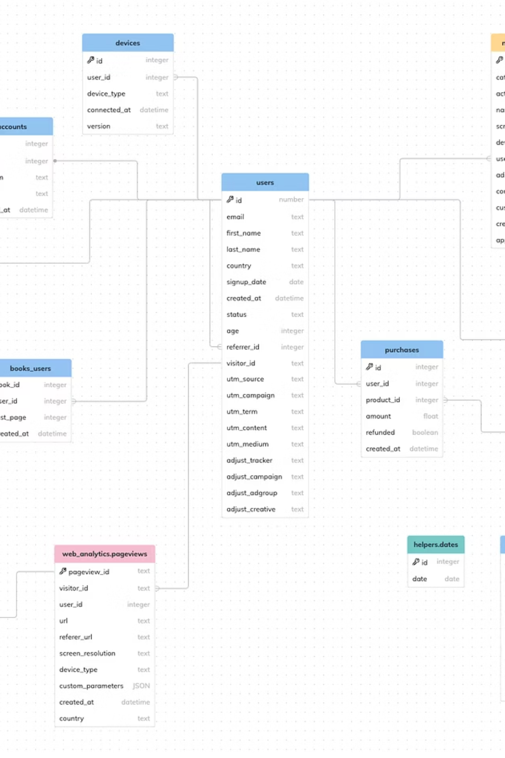
Understanding MySQL Datatypes: The Foundation of Database Design
Datatypes are the building blocks of any database system, defining how data is stored, processed, and retrieved. This presentation explores the fundamental concepts of datatypes in MySQL and their critical role in efficient database design.

Slide 3



Primitive Datatypes: The Basic Building Blocks
Numeric Types
String Types
Temporal Types
INT stores whole numbers like 42 or -99
CHAR(n) for fixed-length strings
DATE for dates (YYYY-MM-DD)
FLOAT/DOUBLE for decimal values like 3.14
VARCHAR(n) for variable-length text up to n characters
TIME for time values (HH:MM:SS)
DATETIME for combined date and time
DECIMAL for precise financial calculations
TEXT for longer content like paragraphs
Primitive datatypes are the foundation of database columns, storing single values with predictable memory requirements and behavior.

Slide 4
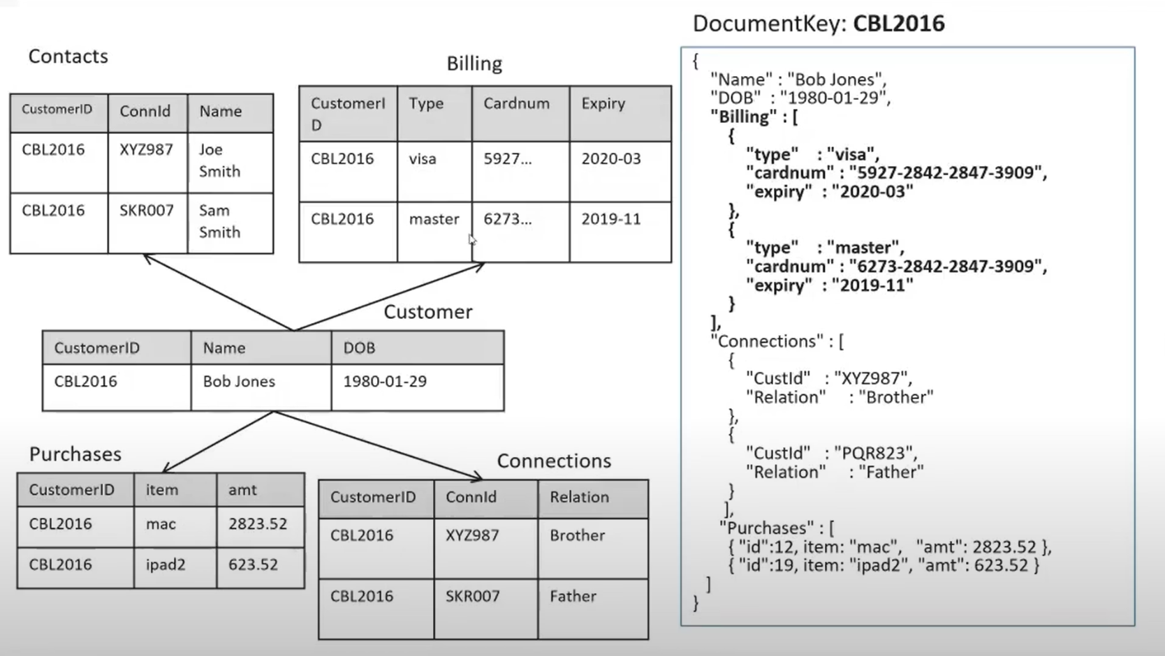
Non-Primitive Datatypes: Advanced Data Storage
Complex Data Structures
Non-primitive datatypes handle more sophisticated data needs when simple values aren't sufficient.
ENUM & SET
ENUM enforces selection from predefined options like sizes ('S','M','L')
SET allows multiple selections from predefined values.
JSON & BLOB
JSON stores structured document data with query
capabilities.
Non-primitive types offer flexibility for complex data requirements while maintaining data integrity through structured formats.
BLOB types store binary data like images, files
or documents.

Slide 5
Numeric Data type
Types of Numeric Data Type
INTEGER
DECIMAL
BYTES

Slide 6
INTEGER
Data Type | Storage Size | Range of Values | Common Use Case
TINYINT | 1 byte | 0 to 255 (if unsigned) or -128 to 127 (if signed). | A very small integer. Used for small, whole numbers like a person’s age or a quantity less than 256.
SMALLINT | 2 bytes | -32,768 to 32,767 | A small integer. Ideal for values like the number of pages in a book or a year of manufacture.
INT | 4 bytes | -2,147,483,648 to 2,147,483,647 | The standard integer. The most common choice for general-purpose whole numbers, like user IDs or product counts.
BIGINT | 8 bytes | -9,223,372,036,854,775,808 to 9,223,372,036,854,775,807 | A very large integer. Used for extremely large numbers, like transaction IDs in a global financial system or scientific data.
MEDIUMINT | 3 Bytes | -8,388,608 to 8,388,607 | Suitable for representing medium-sized integer values .

Slide 7
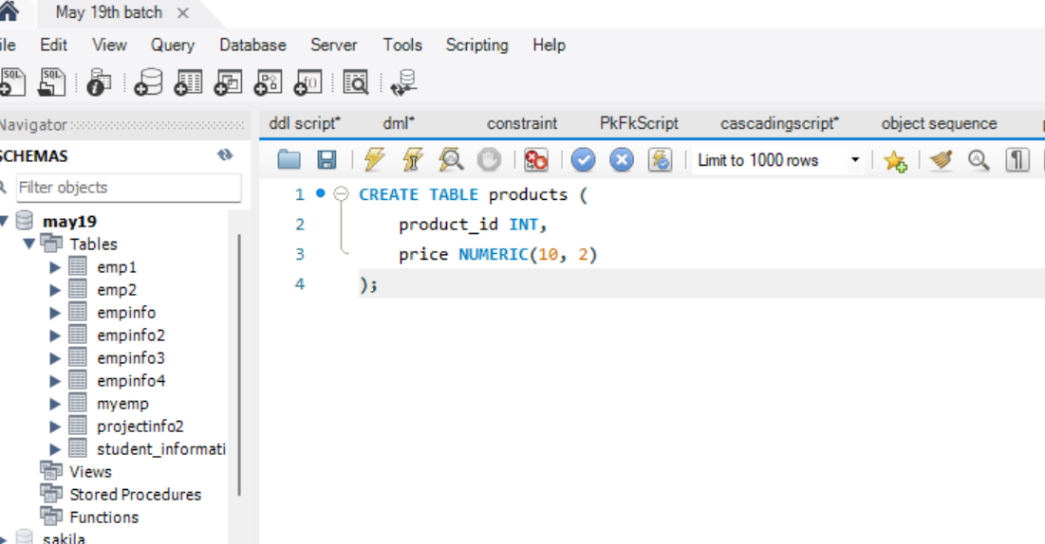
Example :
Suppose you want to create a database table called "products" with columns for product IDs and prices. You can define the price column as a fixed-point numeric data type (NUMERIC) with a precision of 10 and a scale of 2 (for two decimal places):

Slide 8
DECIMAL
The decimal data type is an exact numeric data type defined by its precision (total number of digits) and scale (number of digits to the right of the decimal point).
syntax: decimal (p,s)
Where : p Defines the precision. Minimum is 1; maximum is 38.s Defines the scale. The scale of a decimal value cannot exceed its precision. Scale can be 0 (no digits to the right of the decimal point).
BYTES
The BYTE data type stores any kind of binary data in an undifferentiated byte stream.
Byte Allows whole numbers from 0 to 255.
Its storage is 1 byte.

Slide 9
STRING DATA TYPE
Types of String Data type
CHAR
VARCHAR
Text

Slide 10

WHAT DO YOU MEAN BY String DATA TYPE ?
In MySQL, a String Data Type is used to store sequences of characters such as words, sentences, or any combination of letters, numbers, and symbols.
It includes both fixed-length and variable-length types, allowing storage of short labels or large text content.

Slide 11
Char(n)
A data type in SQL that helps to store characters (alphabets, whole numbers (0-9) or alphanumeric).
It holds maximum 2000 characters.
It Follow FLMA Rule (Fixed Length Memory Allocation) i.e. it stores value in fixed lengths.
Programmers can use CHAR when the sizes of the column data entries are consistent (same).
SYNTAX: CHAR(size) e.g; CHAR(10)

Slide 12
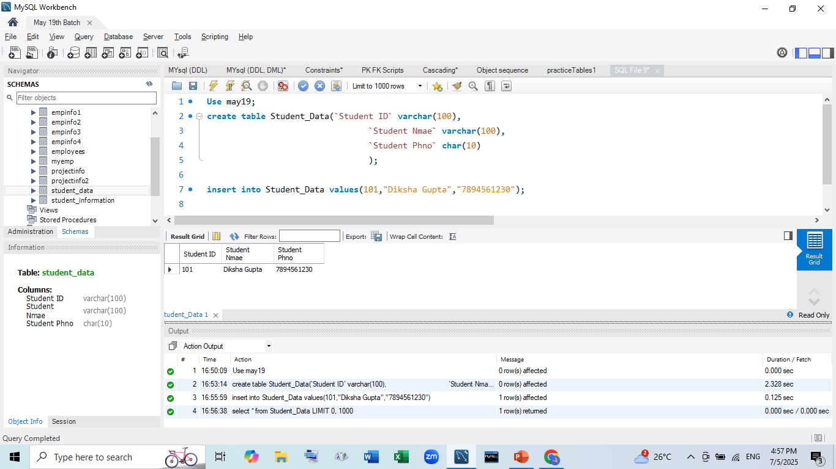
Example :

Slide 13
varchar
VARCHAR stands for Stands for Variable Characters .
It is used to store Alphanumeric Data (Letters, Numbers, Symbols).
E.g. If we define column as VARCHAR(20) , and enter only 6 characters, SQL will store Just those 5 characters, not the entire 20.
This makes it efficient for memory usage, especially when text length is unknown.

Slide 14
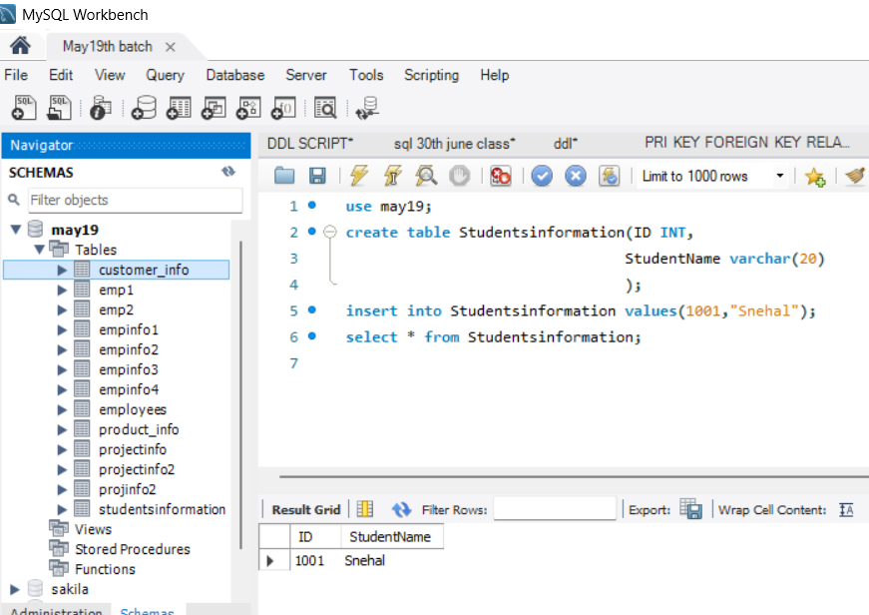
Example:

Slide 15

What is TEXT in MySQL?
TEXT DATA TYPE
The TEXT Data Type stores large amounts of character data (string values) that exceed VARCHAR limits.
Key Characteristics :
Cannot have default values in most implementations.
Stored separately from the main table row.
Case-insensitive by default (configurable).
Non-indexable beyond certain prefix length.

Slide 16
Temporal data type
Temporal data types in MySQL are used to store data related to date and time.
Below are the common temporal data types available in MySQL.
DATE
TIME
DATETIME
TIMESTAMP
YEAR

Slide 17
Temporal Data Type
DATA TYPE | FORMAT | COMMON USE CASE
DATE | YYYY-MM-DD | It is used for storing calendar date without time.
TIME | HH:MM:SS | Represents time of day, useful in logs, events etc.
DATE TIME | YYYY-MM-DD HH:MM:SS | Stores both date and time, ideal for timestamps in systems.
TIMESTAMP | YYYY-MM-DD HH:MM:SS | Auto-update fields used for tracking changes.
YEAR | YYYY | Stores year value, useful for storing year

Slide 18
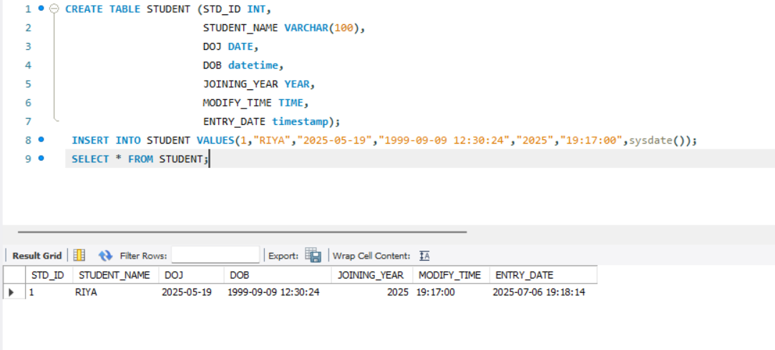
Example:

Slide 19
Conclusion
In MySQL, Data Types define how data is stored, processed, and used.
From numbers and text to dates and JSON, each data type helps store information in the most suitable format for an application’s needs.
A strong understanding of MySQL data types enables better handling of numeric, textual, temporal, and structured data, resulting in reliable and scalable database systems.
By selecting the correct data type for each field, databases become faster, more precise, and easier to manage.
Properly chosen data types also reduce errors, improve storage efficiency, and simplify future database modifications.
In short, smart data type selection leads to smarter and more efficient database design.

Slide 20


